Slide 1

LIBRARY MANAGEMENT
SYSTEM
Bisu Indrakaran Reddy

Slide 2

MANAGEMENT SYSTEM

Slide 3
The Library Management System is used to manage all library activities in a digital way.
It helps to keep records of books, authors, publishers, and library members.
The system makes it easy to issue and return books.
It tracks the availability and number of copies of each book.
Borrowers can borrow and return books, and their details are stored in the system.
It connects information about books, authors, publishers, and branches.
It helps librarians to quickly search, add, or update book and member information.
The system saves time, reduces manual work, and avoids record-keeping errors.
The main goal is to make library management simple, efficient, and organized.
INTRODUCTION

Slide 4
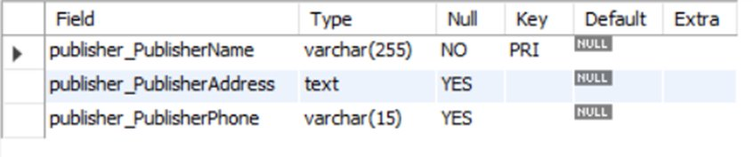
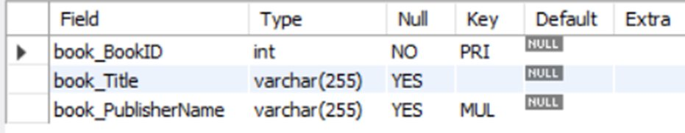
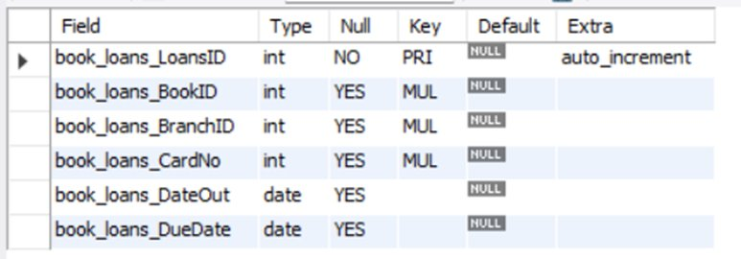
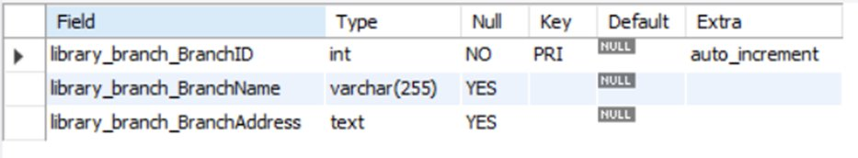
Tables
Publisher
Books
Book Loans
Library Branch

Slide 5
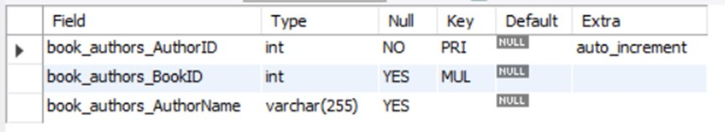
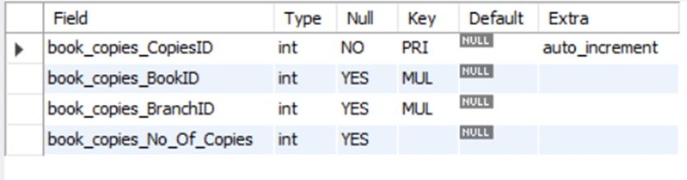
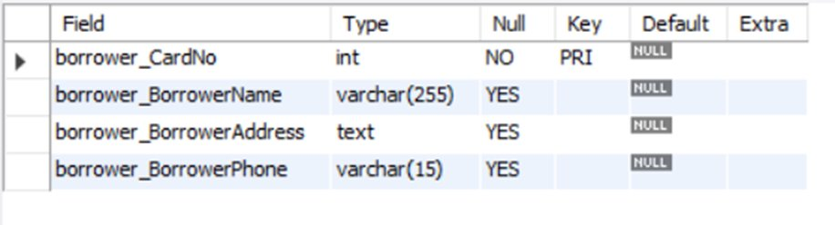

Book Copies
Book Authors
Book Borrowers

Slide 6
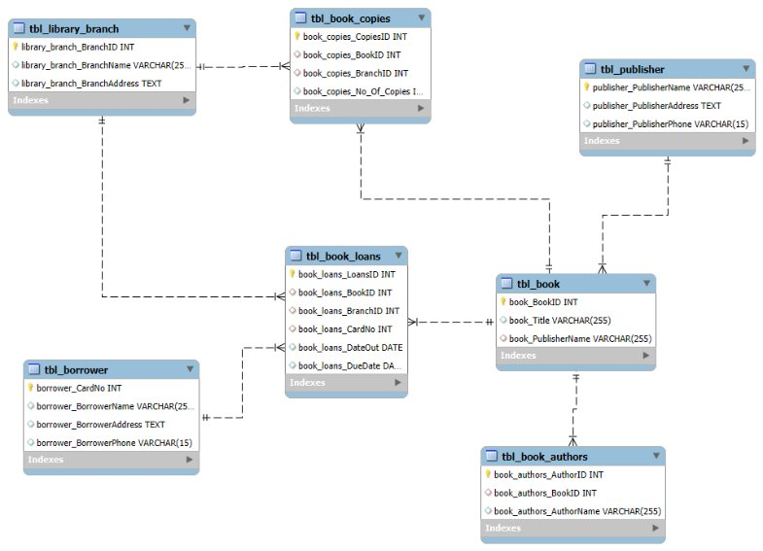
ER DIAGRAM

Slide 7
PROBLEM STATEMENT
Manual management of library operations often leads to errors, data duplication, and difficulty in tracking books, borrowers, and transactions. To overcome these challenges, there is a need for a digital Library Management System using SQL that can efficiently store and manage information about books, authors, publishers, borrowers, and branches in a structured database. The system should automate book issuing and returning, monitor the availability of copies across branches, generate useful reports, and ensure data accuracy and consistency. It should also provide fast and easy search and retrieval of information, making library management more efficient, reliable, and well-organized.

Slide 8
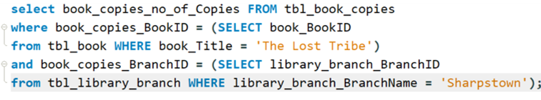

1. How many copies of the book titled "The Lost Tribe" are owned by the library branch whose name is "Sharpstown"?
INSIGHT:
Helps know if enough copies are available or if more should be added.

Slide 9
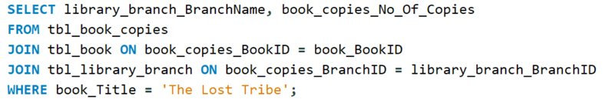
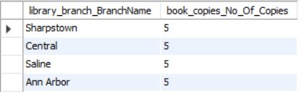
2. How many copies of the book titled "The Lost Tribe" are owned by each library branch?
INSIGHT:
Shows how books are distributed among all branches

Slide 10


3. Retrieve the names of all borrowers who do not have any books checked out.
INSIGHT:
It Helps identify inactive members and encourage them to use the library.

Slide 11
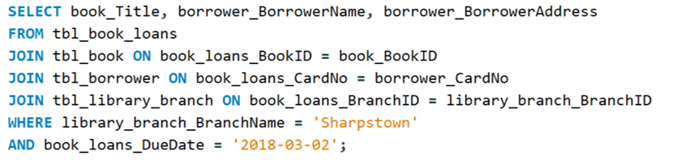
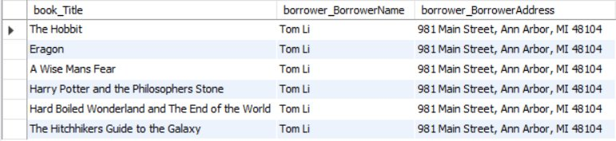
4. For each book that is loaned out from the "Sharpstown" branch and whose Due Date is 2/3/18, retrieve the book title, the borrower's name, and the borrower's address.
INSIGHTS:
Reminds borrowers to return books on time and helps manage due dates.

Slide 12
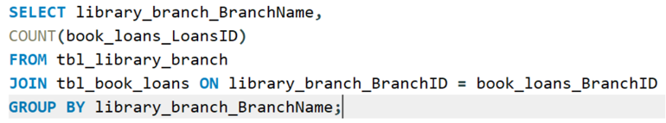
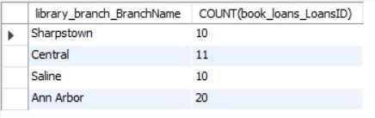
5. For each library branch, retrieve the branch name and the total number of books loaned out from that branch.
INSIGHT:
Helps find out which branch has more activity and which has less.

Slide 13
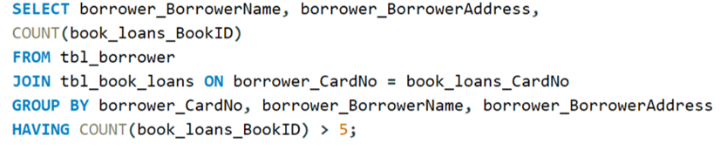
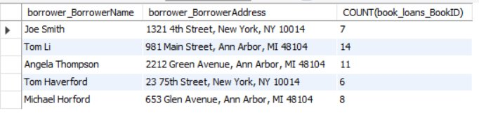
6. Retrieve the names, addresses, and number of books checked out for all borrowers who have more than five books checked out.
INSIGHT:
Makes it easier to track heavy borrowers and manage lending limits or rewards.

Slide 14
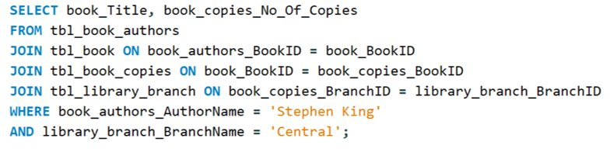

7. For each book authored by "Stephen King", retrieve the title and the number of copies owned by the library branch whose name is "Central".
INSIGHT:
Helps manage and check the availability of popular author books...change starting word helps and generate in simple

Slide 15
CONCLUSION
The Library Management System effectively solves the problems of traditional library management by providing a digital, SQL-based solution for storing and handling all library data. It maintains accurate records of books, authors, publishers, borrowers, and branches, ensuring easy tracking of book availability and transactions. The system simplifies issuing and returning books, reduces manual errors, and saves valuable time. With the help of SQL queries, it allows quick data retrieval, efficient report generation, and better decision-making for librarians. Overall, this project makes library management more organized, transparent, and efficient, improving both user experience and administrative control.

Slide 16
THANK YOU...

